Slide 1
Intro to PHP More About PHP

Slide 2
So far we've covered...
Web Servers & Protocols
Presentation Layer (static pages)
For the rest of the semester...
Application Layer (dynamic pages)
Data Layer (persistence)

Slide 3
Specifically…
PHP MySQL
Authentication/Authorization
Session Handling
Web Security
Web Services
Back-end Workflow

Slide 4
What is PHP?
PHP Hypertext Preprocessor
Yes, it's recursive.
Well-suited to Web development
Can be executed on the command line
Can be executed server-side alongside markup, or any other output
PHP is an Interpreted language
It is Loosely-typed
Notes:
https://stackoverflow.com/questions/2690544/what-is-the-difference-between-a-strongly-typed-language-and-a-statically-typed
A loosely typed language is a programming language that does not require a variable to be defined. For example, Perl is a loosely typed language, you can declarea variable, but it doesn't require you to classify the type of variable.

Slide 5
More About PHP
Configuration resides in php.ini
Additional functionality provided as modular extensions
For instance, MySQL support
The server determines which pages are handled by PHP
*.php by default

Slide 6
Anatomy of a PHP Page
<!-- non-PHP content goes here -->
<?php
$foo = 'Hello world!';
?>
<h1><?php echo $foo ?></h1>
<!-- content continues; doesn't have to be HTML! -->

Slide 7
Syntax Basics
Statements delimited by semi-colons Whitespace ignored
/* C-style comment */
// C++ style comment
# Shell-style comment

Slide 8
PHP Topics
Data Types, Literals & Variables
Operators
Control Structures
Functions
Objects
Basic Web I/O

Slide 9
PHP Variables
$var = 'value’;
Must start with letter or underscore,
can contain letters, numbers and underscores
No need to declare before use
Loosely typed
Variable-named variables are also possible
$$var = 42; // Assign 42 to $value
echo $value; // 42
42

Slide 10
PHP Constants
define(“FOO”, 42); echo FOO;
Must start with letter or underscore, can contain letters, numbers and underscores
Constants are always globally scoped

Slide 11
PHP References
References also possible
Not references in the C++ sense
Not mapped to actual memory addresses
Can't perform pointer arithmetic
Stored in a symbol table instead

Slide 12
PHP References
$a = 12;
$b = &a;
/* $b points to the same place in the symbol table as $a */
$b = 42;
echo $a; // 42
unbound by using unset()
unset($a);
Pass-by-reference also possible

Slide 13
PHP Variable Scope
Global: Created outside of a function's scope. May be accessed using the global keyword
Local: Variables created within a function only available within the same function
Static: As local, only retains value after the function finishes executing. Declared using the static keyword.

Slide 14
PHP Data Types
Boolean
Integer
Float
String
NULL
Arrays
Resources
Objects

Slide 15
PHP Literals
Integers, floats and string literals all work as you'd expect
Empty strings and zero-values evaluate to false
All other non-null values are true

Slide 16
Variable Interpolation
<?php $var = “World”; ?>
Strings in double quotes are evaluated for escaped characters, variables
echo “Hello $var“;
Hello World
Strings in single quotes always interpreted literally
Echo 'Hello $var';
Hello $var
Be Careful!

Slide 17
PHP Arrays
Ordered key-value pairs
$array = array('foo' => 'Hello”, 'bar' => 'World');
echo $array['foo'];
Hello
// Keys will auto-increment if not given
$array = array('foo', 'bar', 'baz');
echo $array[2];
baz
Does not distinguish between indexed and associative arrays
So: Second example is as if we said
$array = array(0=>’foo’, 1=>’bar’, 2=>’baz’)

Slide 18
<aside> PHP Resources
Special type of variable representing a resource to be acted upon like,
special handlers to opened files,
database connections,
image canvas areas, etc…
We'll see a few examples later on...

Slide 19
PHP Operators
Arithmetic Operators
+, -, *, /, …
Ternary
$var = (expr) ? True : false;
i.e. $discountPct = ($havingASale) ? .1 : 0;
Comparison
<, >, ==. !=, ===
Bitwise/Logical
&&, ||, !
Casting
(int), (float), (bool), (string), (array), (object)
Concatenation (.)
like + in javaScript

Slide 20
<aside> Dangerous Operators
@
Suppresses errors for a given expression
@($a = $x/$y);
`` -
Executes content on command line
$listing = `ls -la`;

Slide 21
PHP Control Structures
if/else
if/elseif/else
switch
while
do…while
for
foreach

Slide 22
PHP Control Structures foreach
Iterates over array elements
foreach ($array as $current_item) {
echo $current_item;
}
foreach ($array as $key => $value) {
echo $key . ':' . $value;
}

Slide 23
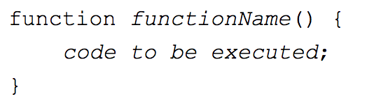
PHP Functions
Declared using the function keyword
A user-defined function declaration starts with the word function:
Can return a value or a reference
Can pass-by-reference
All non-global variables are local
Supports recursion
Notes:
A function name can start with a letter or underscore (not a number).
Give the function a name that reflects what the function does!

Slide 24
PHP Functions
Examples:
function sum($a, $b) {
return $a + $b;
}
function increment($a) {
$a++;
}

Slide 25
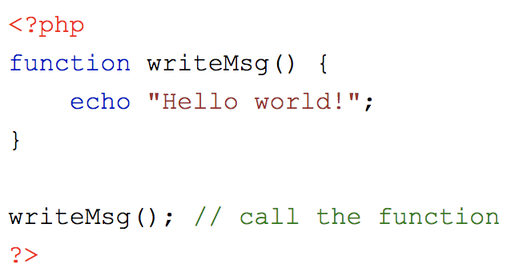
Functions
- Besides the built-in PHP functions, we can create our own functions.
A function is a block of statements that can be used repeatedly in a
program.
- A function will not execute immediately when a page loads.
- A function will be executed by a call to the function.
Resource: https://www.w3schools.com/php/php_functions.asp
Notes:
If you want to execute a function, you have to call that function.

Slide 26
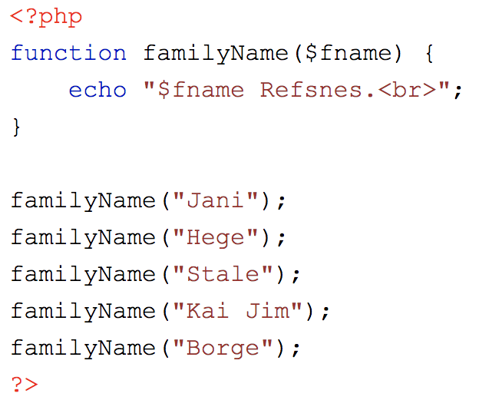
PHP Function Arguments
Information can be passed to functions through arguments. An argument is just like a variable.
Arguments are specified after the function name, inside the parentheses. You can add as many arguments as you want, just separate them with a comma.
Resource: https://www.w3schools.com/php/php_functions.asp

Slide 27
Returning References
The caller must expect a reference being returned!
function &get_array_elem(&$arr, $i) {
return $arr[$i];
}
// Only assigns a copy of $a[42]
$foo = get_array_elem($a, 42);
// Assigns the same reference as $a[42]
$foo = &get_array_elem($a, 42);

Slide 28
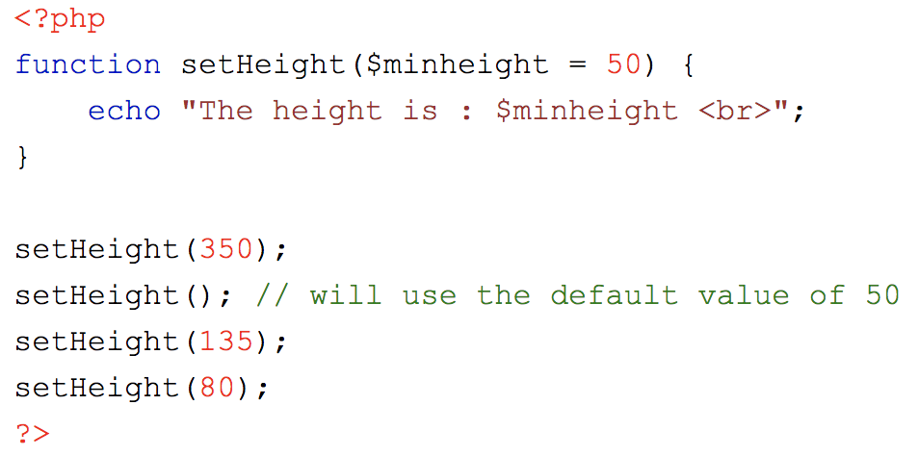
PHP Default Argument Value
This example shows how to use a default parameter. If we call the function setHeight() without arguments it takes the default value as argument:
Resource: https://www.w3schools.com/php/php_functions.asp

Slide 29
Default Parameters
Defaults will be used if params omitted
Must be declared after required params
function add($num, $i = 1) {
return $num + $i;
}

Slide 30
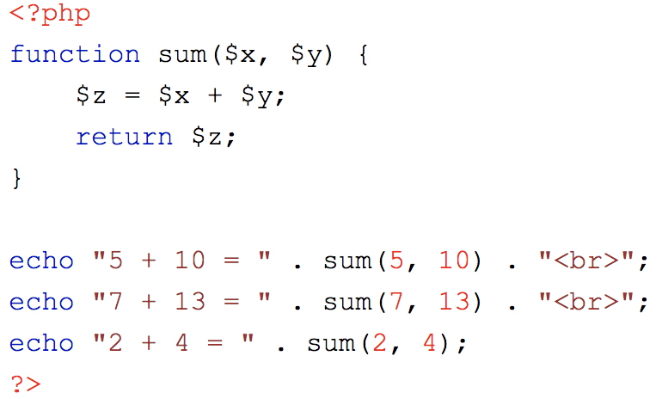
PHP Functions - Returning values
To let a function return a value, use the return statement:
We use the “return” keyword to return a value from a function
Resource: https://www.w3schools.com/php/php_functions.asp

Slide 31
Function Reference
http://www.php.net/manual/en/funcref.php
String manipulation
Regular expressions
Array manipulation
Database and network handling
See the Reference Page for more details.

Slide 32
PHP Objects
Single inheritance
Protection (public/private/protected) for methods or member variables
Support for interfaces

Slide 33
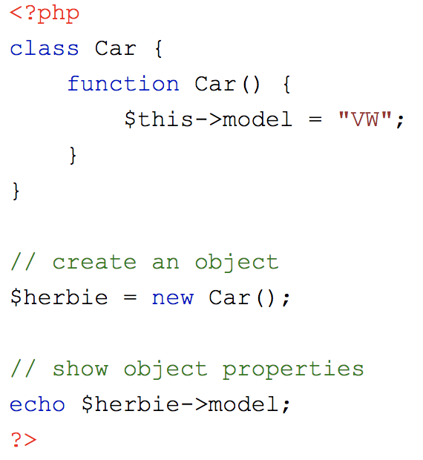
PHP Objects
An object is a data type which stores data and information on how to process that data.
In PHP, an object must be explicitly declared.
First we must declare a class of object. For this, we use the class keyword. A class is a structure that can contain properties and methods:
https://www.w3schools.com/php/php_datatypes.asp

Slide 34
PHP Objects
Creation: $foo = new MyClass();
Methods: $foo->method();
Member variables: $foo->var;
Notes:
here

Slide 35
Anatomy of a Class
class Person {
private $fname;
private $lname;
public function __construct($fn, $ln) {
$this->fname = $fn;
$this->lname = $ln;
}
public function getName() {
return $this->fname . ‘ ‘ . $this->lname;
}
}
Notes:
Class is a programmer-defined data type, which includes local functions as well as local data. You can think of a class as a template for making many instances of the same kind (or class) of object.

Slide 36
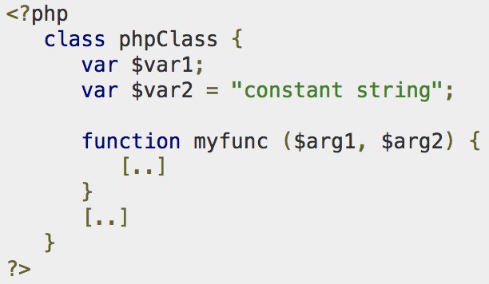
Defining PHP Classes
The general form for defining a new class in PHP is as follows −
The special form class, followed by the name of the class that you want to define.
A set of braces enclosing any number of variable declarations and function definitions.
Variable declarations start with the special form var, which is followed by a conventional $ variable name; they may also have an initial assignment to a constant value.
Function definitions look much like standalone PHP functions but are local to the class and will be used to set and access object data.
Resource: https://www.tutorialspoint.com/php/php_object_oriented.htm

Slide 37
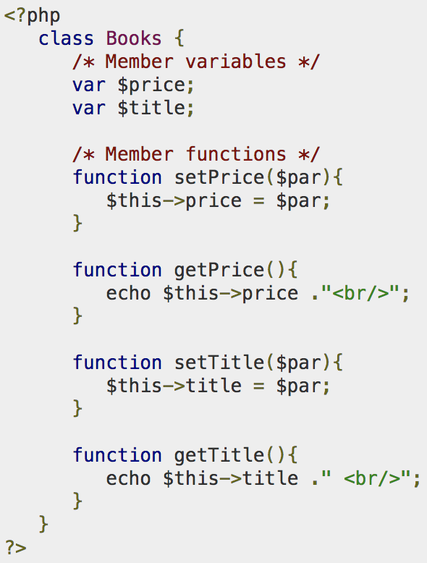
Example: PHP Class
Here is an example which defines a class of Books type −
The variable $this is a special variable and it refers to the same object ie. itself.
Resource: https://www.tutorialspoint.com/php/php_object_oriented.htm

Slide 38
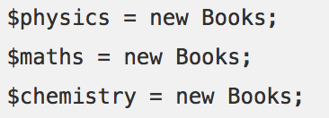
Once you defined your class, then you can create as many objects as you like of that class type. Following is an example of how to create object using new operator.
Here we have created three objects and these objects are independent of each other
and they will have their existence separately.
Resource: https://www.tutorialspoint.com/php/php_object_oriented.htm
Notes:
Next we will see how to access member function and process member variables.

Slide 39
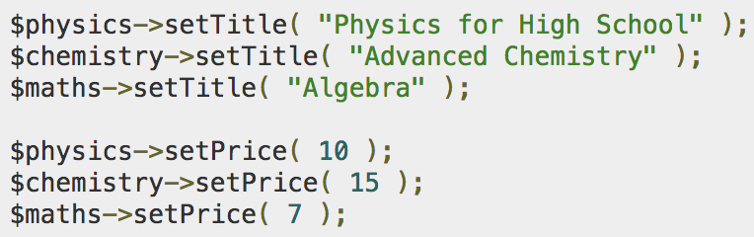
Calling Member Functions
After creating your objects, you will be able to call member functions related to that object.
One member function will be able to process member variable of related object only.
Following example shows how to set title and prices for the three books by calling member functions.
Resource: https://www.tutorialspoint.com/php/php_object_oriented.htm

Slide 40
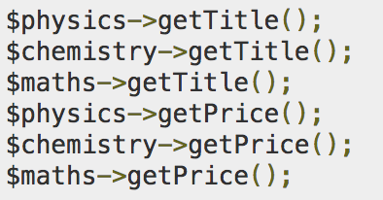
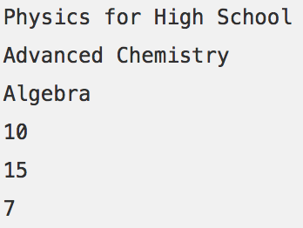
Now you call another member functions to get the values set by in above example −
This will produce the following result −

Slide 41
This will produce the following result −

Slide 42
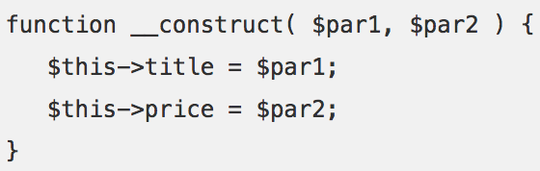
Constructor Functions in PHP
Constructor Functions are special type of functions which are called automatically whenever an object is created.
We can take the full advantage of this behavior, by initializing many things through constructor functions.
PHP provides a special function called __construct() to define a constructor. You can pass as many as arguments you like into the constructor function.
Following example will create one constructor for Books class and it will initialize price and title for the book at the time of object creation.
Resource: https://www.tutorialspoint.com/php/php_object_oriented.htm
Notes:
So we take full advantage of this behaviour, by initializing many things through constructor functions.

Slide 43
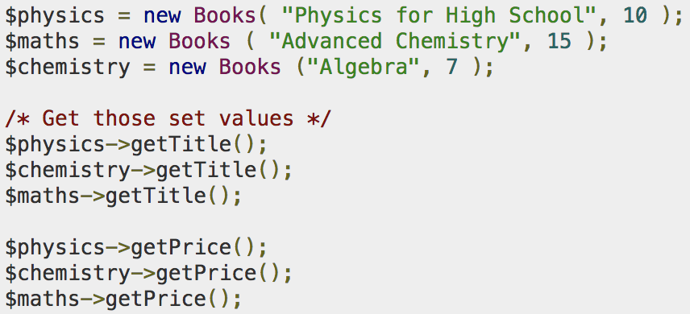
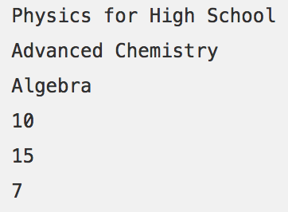
Now we don't need to call set function separately to set price and title. We can initialize these two member variables at the time of object creation only. Check following example below −
This will produce the following result −
Resource: https://www.tutorialspoint.com/php/php_object_oriented.htm

Slide 44
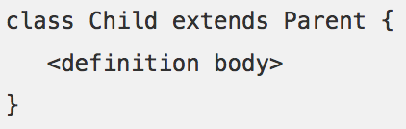
PHP Inheritance
PHP class definitions can optionally inherit from a parent class definition by using the extends clause. The syntax is as follows −
The effect of inheritance is that the child class (or subclass or derived class) has the following characteristics −
Automatically has all the member variable declarations of the parent class.
Automatically has all the same member functions as the parent, which (by default) will work the same way as those functions do in the parent.
Resource: https://www.tutorialspoint.com/php/php_object_oriented.htm

Slide 45
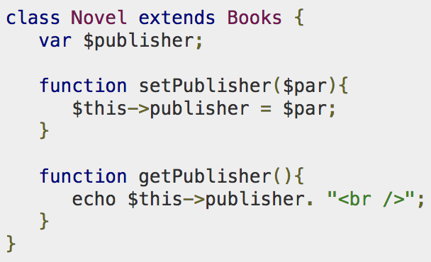
Following example inherit Books class and adds more functionality based on the requirement.
Resource: https://www.tutorialspoint.com/php/php_object_oriented.htm

Slide 46
PHP Inheritance
class Student extends Person {
private $rin;
public function __construct($fn, $ln, $r) {
// call the parent constructor
parent::__construct($fn, $ln);
$this->rin = $r;
}
}

Slide 47
PHP Basic Output
echo/print – Print to output
print_r($var) – Print recursively (arrays, objects)
var_dump($var) – Detailed information about a variable

Slide 48
PHP Basic Input
Special global arrays called superglobals contain information about the request
http://www.php.net/manual/en/reserved.variables.php
$_GET – Key-value pairs passed along the query string
Ie. http://example.com/index.php?id=42
echo $_GET['id']; // 42

Slide 49
PHP Basic Input
$_POST – Key-value pairs passed along via POST
<form method=”post” action=”index.php”>
<input type=”text” name=”color” id=”color” />
<input type=”submit” />
</form>
<?php echo $_POST['color']; ?>
$_REQUEST – All key-value pairs that were sent this request

Slide 50
</class>
Lab 6 – PHP Basics

